Slide 1
OCA Organization Chart

Slide 2
Office of the City Administrator
City Administrator
Chief of Staff
Deputy City Administrator
DM PSJ & GovOps
Office of Performance Management
Office of Budget & Finance
Administration & Logistics
Communications & External Affairs OCA, PSJ & Gov Ops
Agency Operations
General Counsel & Grants
Office of Labor Relations & Collective Bargaining
Government Operations
Public Safety & Justice
Office of Public Private Partnerships
Office of Resilience

Slide 3
Administration
Tonya Thompson
(Special Assistant to the City Administrator)
Tim Banner (Executive Assistant to the City Administrator)
Wendell Felder (Community Outreach Specialist)
Lance Holt (Staff Assistant)
Sharona Morgan* (Program Analyst)
Paris Palmer (Administrative Support Assistant)
* Denotes Detaille

Slide 4
Communications and External Affairs
Olivia Walton-Dedner
(Communications Director)
Arlen Herrell (Policy Advisor)

Slide 5
Agency Operations
Agency Operations
Ayana Rockett
(Ed and EOM)
Ariel Giles
(DMGEO)
Kasmin Holt
(DMPED)
Kasmin Holt
(DMPED)
Nathan Mulat
(DMHHS)
Kasmin Holt
(DMPED)
Ayana Rockett
(Ed and EOM)

Slide 6
General Counsel and Grants Management
Barry Kreiswirth
(General Counsel and Senior Policy Advisor)
Ida Jones
(Grants Management Specialist)
Kenneth Liebowitz (Attorney Advisor)

Slide 7
Office of Budget and Finance (OBF)
Jenny Reed (Interim Director)
Alexis Griffin
(Senior Budget Analyst)
(Health and Human Services)
Chris Murray
(Senior Budget Analyst)
(Government Direction & Support)
Jared Botchway
(Budget Analyst)
(Public Works & CIP)
Colin Sollitt
(Budget Analyst)
(Economic Development)
Vacant (Deputy Director) (Education)
John McGraw (Deputy Director, CIP)
Daniel Kornfield
(Senior Budget Analyst, Public Safety and Justice)
Notes:
Build on Transition Plan
100 Day goals
A Plan for the First Term.
Set our eyes on the horizon and think about having the biggest impact possible on citizens lives.

Slide 8
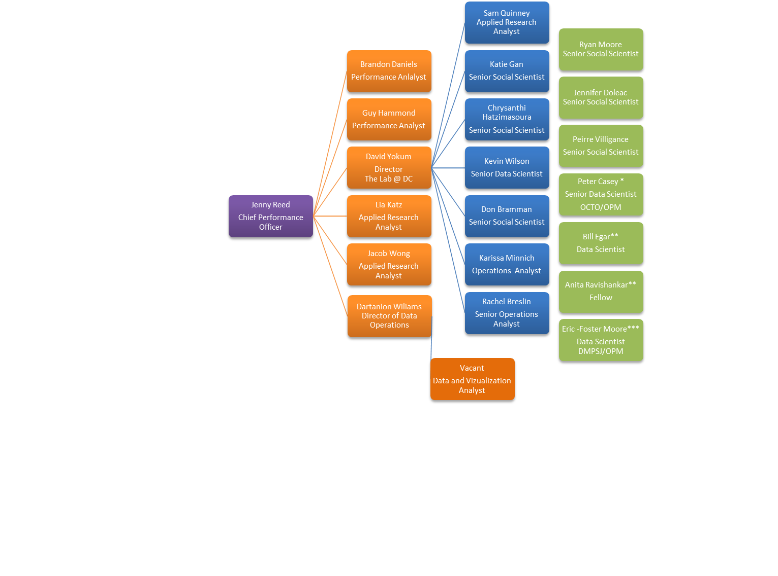
Office of Performance Management
* Salary paid by OCTO
**Salary paid by MPD
***Salary paid by DMPSJ

Slide 9
Office of Public-Private Partnerships (OP3)
Seth Miller Gabriel
(Director)
Judah Gluckman
(Deputy Director)

Slide 10
Office of Resilience
Kevin Bush
(Director)
Harrison Newton
(Deputy Director)

Slide 11
Office of Labor Relations & Collective Bargaining (OLRCB)
Lionel Sims
(Director)
Dean Aqui (Supervisory Attorney Advisor, Negotiation)
Michael Levy (Supervisory Attorney Advisor, Litigation)
Kevin Stokes
(Chief of Staff)
Public Safety & Justice Cluster
Education Cluster
Operations, Planning & Economic Development Cluster
Health & Human Services Cluster
Administrative Support
Training Research
Special Projects
Repunzelle Bullock
(Attorney Advisor)
Kathryn Naylor
(Attorney Advisor)
Herman Brown Jr.
(Attorney Advisor)
Stephanie Maltz
(Attorney Advisor)
Mary Redfearn
(Executive Assistant)
Kyle Simmons
(Special Projects)
VACANT
(Attorney Advisor)
Asha Bryant
(Attorney Advisor)
Vincent Harris
(Attorney Advisor)
Phyllis Kaiser-Dark
(Administrative Officer)
VACANT
(Attorney Advisor)
Michael Hathaway
(Attorney Advisor)
Issac McLaughlin
(Clerk)

Slide 12
Public Safety & Justice and Government Operations
Kevin Donahue
(Deputy City Administrator /
Deputy Mayor for Public Safety, Justice & Operations)
Helder Gil
(Chief of Staff, Public Safety and Justice)
Lyndsey Miller-Vierra (Chief of Staff, Government Operations)
Shae Harris (Policy Advisor)
Christina Murphy
(Program Analysis Officer)
John Mein
(Community Outreach Specialist)
Alexandra Caceres
(Program Analyst)
Vacant
(Program Analyst)
Eric FosterMoore
(Applied Research Analyst)
Shelley Vanneman
(Attorney-Advisor)

